Slide 1
Cloud Deployment Models
Week 6th
CE-308
Safia Baloch

Slide 2
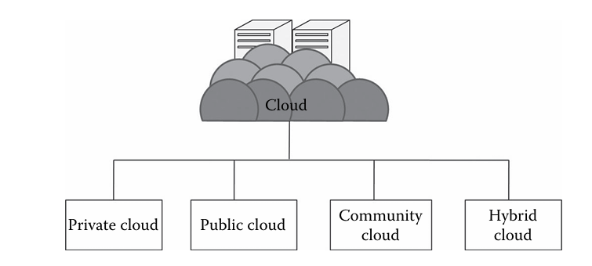
Choosing right deployment model for your organization
Technical requirement, operational preference, cost consideration
Technology Fit
Operational Fit
Cost

Slide 3
Model Based Deployment
Deployment Model: how resources of a system are employed to execute the application function.
Beyond the capabilities of the resources, it is deployment that essentially determines the runtime properties of the system , e.g.
Responsiveness, reliability, availability.
The automatic, or machine supported design of a deployment.
What is Deployment? “Central resource broker”

Slide 4
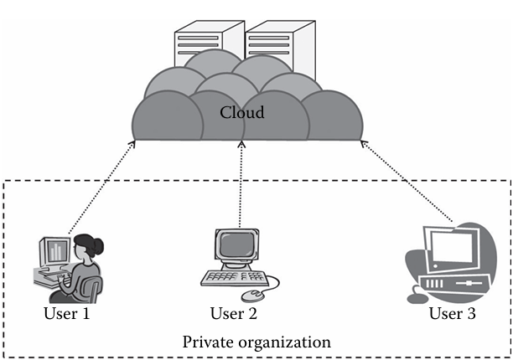
Private Cloud
Referred as “internal cloud”, Traditional IT environment
Incorporates cloud characteristics , if designed with virtualization and orchestration tools
Benefits of Private Cloud:
Complete control over entire stack
Enhanced security to keep sensitive data in-house
Customization of infrastructure to meet specific business needs.
On demand data availability

Slide 5
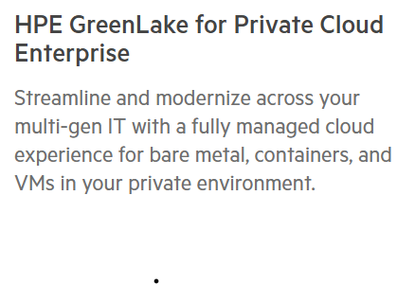
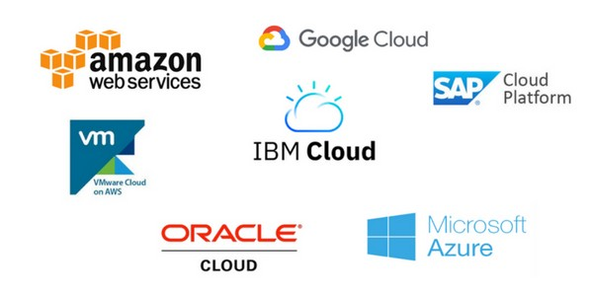
Vendors of Private Cloud
Private cloud stacks:
Vmware
Microsoft
RedHat: subsidiary of Ibm:
Dell EMC: PowerFlex
OpenStack
HPE: Hewllet Packard Enterprise

Slide 6
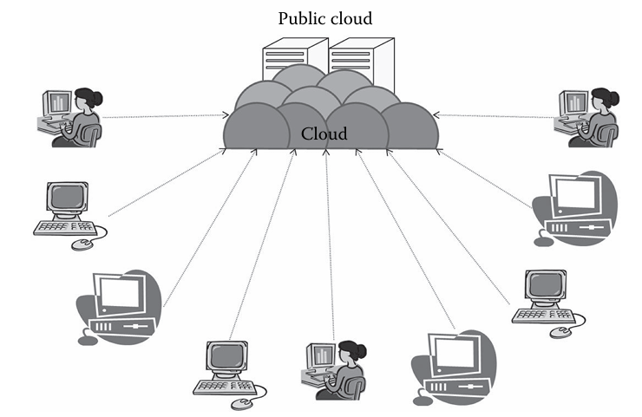
Public Cloud
Referred as “Cloud Computing”
IT services on infrastructure provided by third party.
Operate on Multi tenant model ( multiple customers sharing same infrastructures)
Suitable for which type of business ?
Benefits of Public Cloud:
Cost Efficiency: Pay as you go
Scalability for resources up and down over demand
Accessibility from anywhere with an internet.

Slide 7
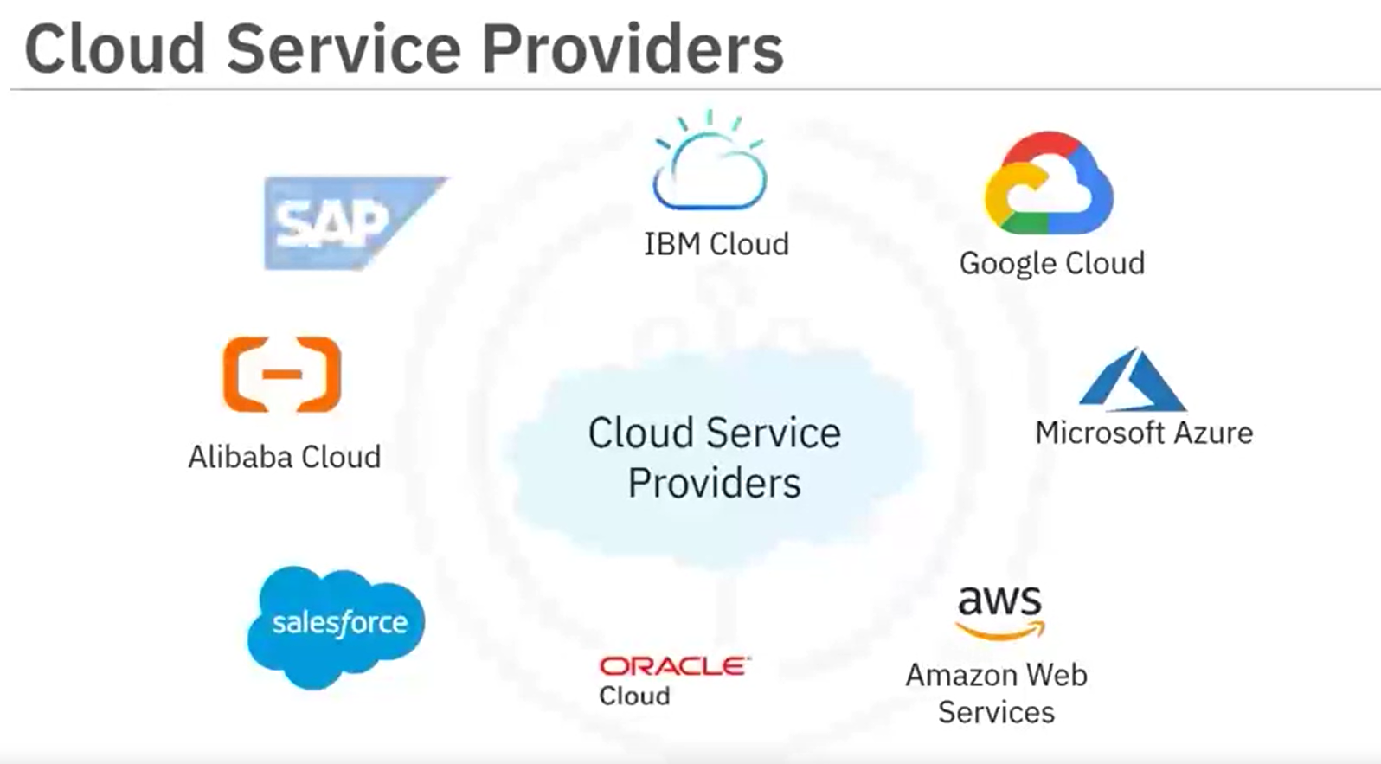
Vendors of Public Cloud
Amazon Web Services
Microsoft Azure
Google Cloud Platform

Slide 8
Hybrid Cloud
Combination of private and public clouds
Creating flexible and unified environment
Organization which requires balance between security, compliance, performance.
E.g. storing data in a private cloud for compliance reasons and using public cloud services to deploy customer facing applications globally.
Cloud Bursting ?
How can you implement cloud bursting on AWS?
When do organization use cloud bursting?
Marketing campaigns
Big Data analytics

Slide 9
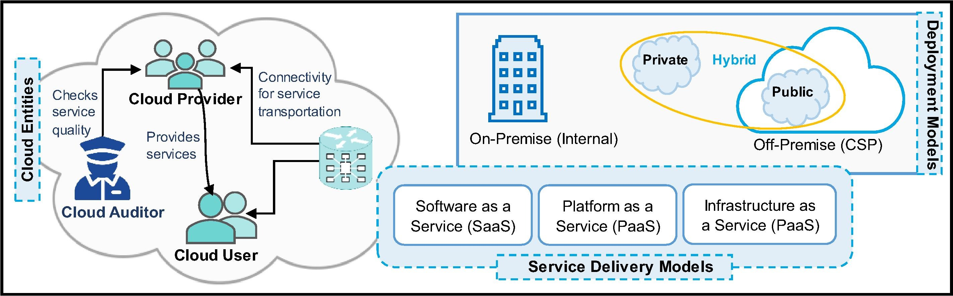
Benefits of Hybrid Cloud Flexibility between on premises, private, public cloud Scalability Compliance

Slide 10
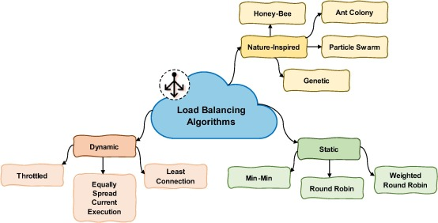

Slide 11
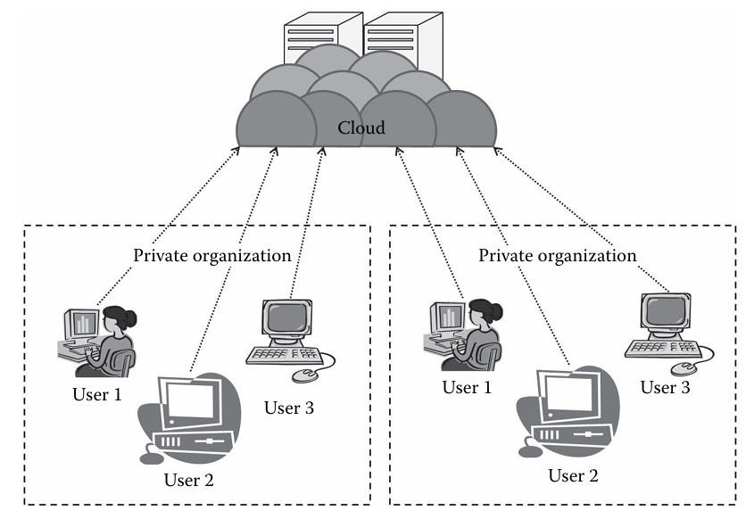
? Cloud

Slide 12
MultiCloud
Multiple cloud services from different providers simultaneously
E.g. an organization might use Microsoft Azure for certain workloads and AWS for others.
Complex to manage
Benefits of Multicloud:
Vendor Independence to reduce reliance on single cloud provider
Cost Optimization by choosing the best/suitable provider for each workload
Flexibility in operations and resilience

Slide 13
Ideal Deployment Model for following use cases( private or public)
Relieve demand on IT resources
Protect sensitive information, including intellectual property
Scale up quickly and accelerate time to market
Meet data sovereignty or compliance requirements
Run workloads over the short term
Ensure high availability
Manage upfront costs

Slide 14
Cloud Computing Challenges
Paper for overview : Current Development, Challenges and Future Trends in Cloud Computing: A Survey
Security
Reliability and Tolerance
Resource Management and Scalability
Privacy and Compliance
Cost Management
Performance and Latency
Environment Impact
Adoption Challenges
Future Direction to address challenges ?

Slide 15
Security Challenges
Data Breaches and Unauthorized Access
2014 Dropbox hacked , over 50 million accounts were compromised
Solution?
Malicious insiders
Denial of Service (DoS) Attacks
Implementing robust firewall and intrusion detection systems
Using content delivery network to distribute traffic
Shared Technology Vulnerabilities (Multi-Tenancy can lead to side channel attacks )
Solution ?
Lack of transparency
User lack visibility into where their data is stored and how it is secured.
Solution
Clear service level agreement with providers
Adoption of standard s like ISO 27002 for cloud security

Slide 16
Reliability and Fault Tolerance
Service Outages
Downtime due to hardware failures, software bugs, or network issues
Microsoft anf AWS outages
Fault Tolerance
Hardware and software failure can disrupt the services
Efficient fault tolerant algorithms and regular backups / disaster recovery plans can help

Slide 17
Resource Management and scalability
Resource provisioning
Over provision lead to waste of resource and under provision lead to performance degradation
Dynamic resource allocation using auto scaling
Algorithms to predict forecast resource demands , time series etc.
Load balancing
Bottleneck due to uneven distribution
Load balancing algorithms
Containerization for efficient resource utilization
Scheduling
Inefficient scheduling of tasks will delay and increase cost
Round robin, priority based scheduling algorithms are solution

Slide 18
Privacy and Compliance
Data Privacy : crucial for sensitive industries
Accessible by unauthorized parties and governments
Encryption is the solution
Regulatory Compliance
Every region have varying regulation (GDPR in Europe , HIPAA in USA, personal data protection bill 2023 in Pakistan )
Ensuring cloud provider comply with relevant regulations
Regular audits and compliance checks

Slide 19
Cost Management
Cloud reduce capital cost but challenges operational cost
Hidden costs
Cost increase due to data transfer fee, storage over usages, or premium services
Using cost management tools provided by cloud providers
Vendor Lock In
Using open standards and APIs to ensure interoperability

Slide 20
Performance and latency
Network Latency
delay in Data transfer impact real time applications.
E,g ?
Edge Computing can bring services closer to user
Optimizing network configuration and protocol
Resource Contention
Inevitable to avoid in multi tenancy
For critical application , dedicated resources can be used

Slide 21
Environment Impact
Energy Consumption
Read
The Staggering Ecological Impacts of Computation and the Cloud by mit press feb 2022

Slide 22
Adoption Challenge
Adoption problem for small or medium enterprises (SMEs)
Lack of Expertise
Change management
Clear communication of benefits and ROI
Gradual migration to the cloud

Slide 23
Future
AI : predictive analytics,
Blockchain, Enhancing data Security and transparency
Edge Computing : reduce latency and improve performance
Quantum Computing : advance encryption and computational capabilities

